Slide 1
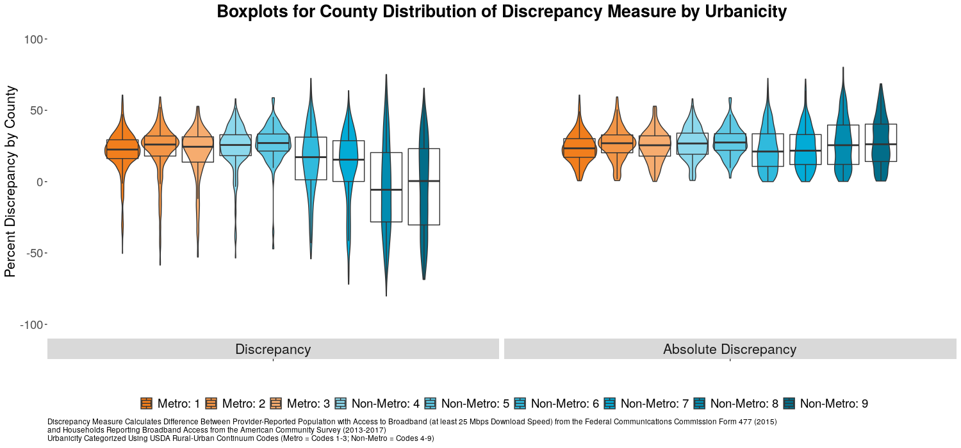
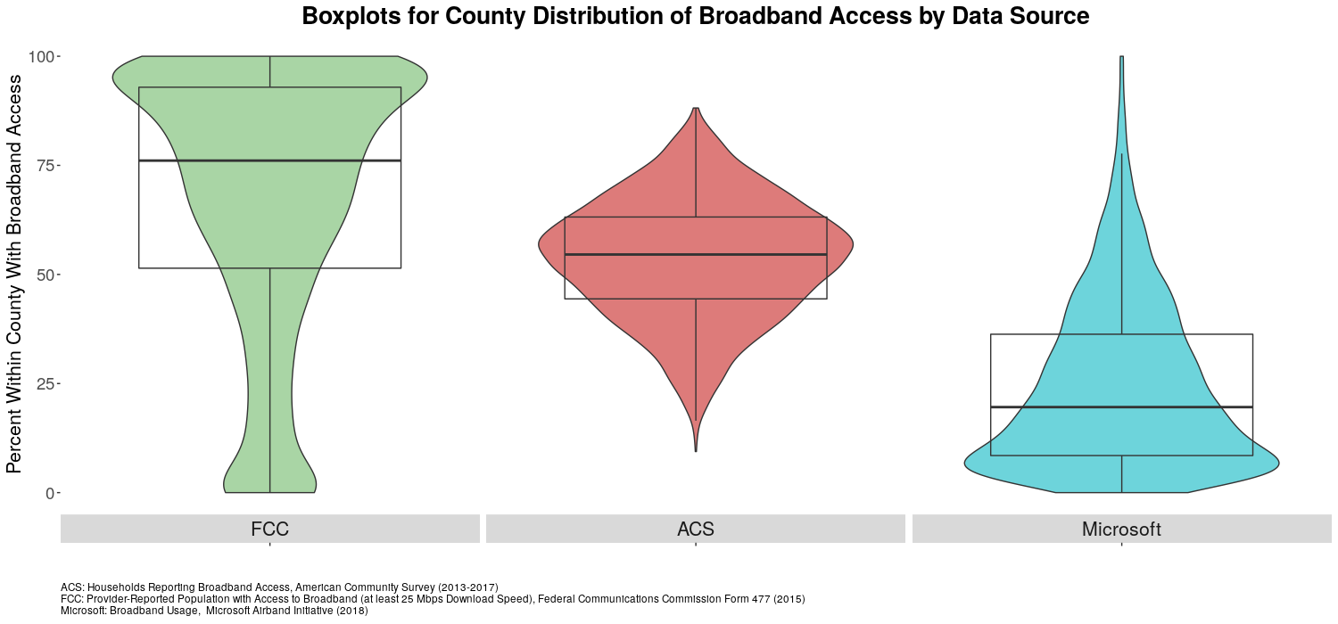
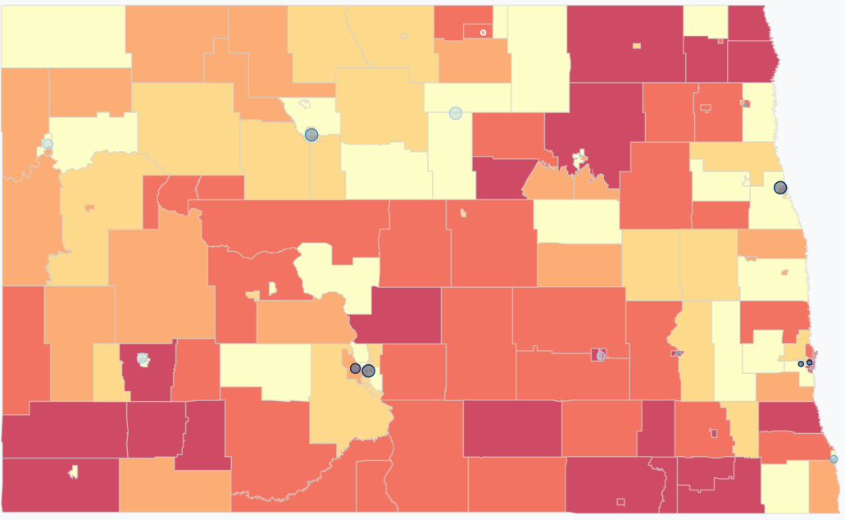
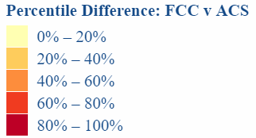
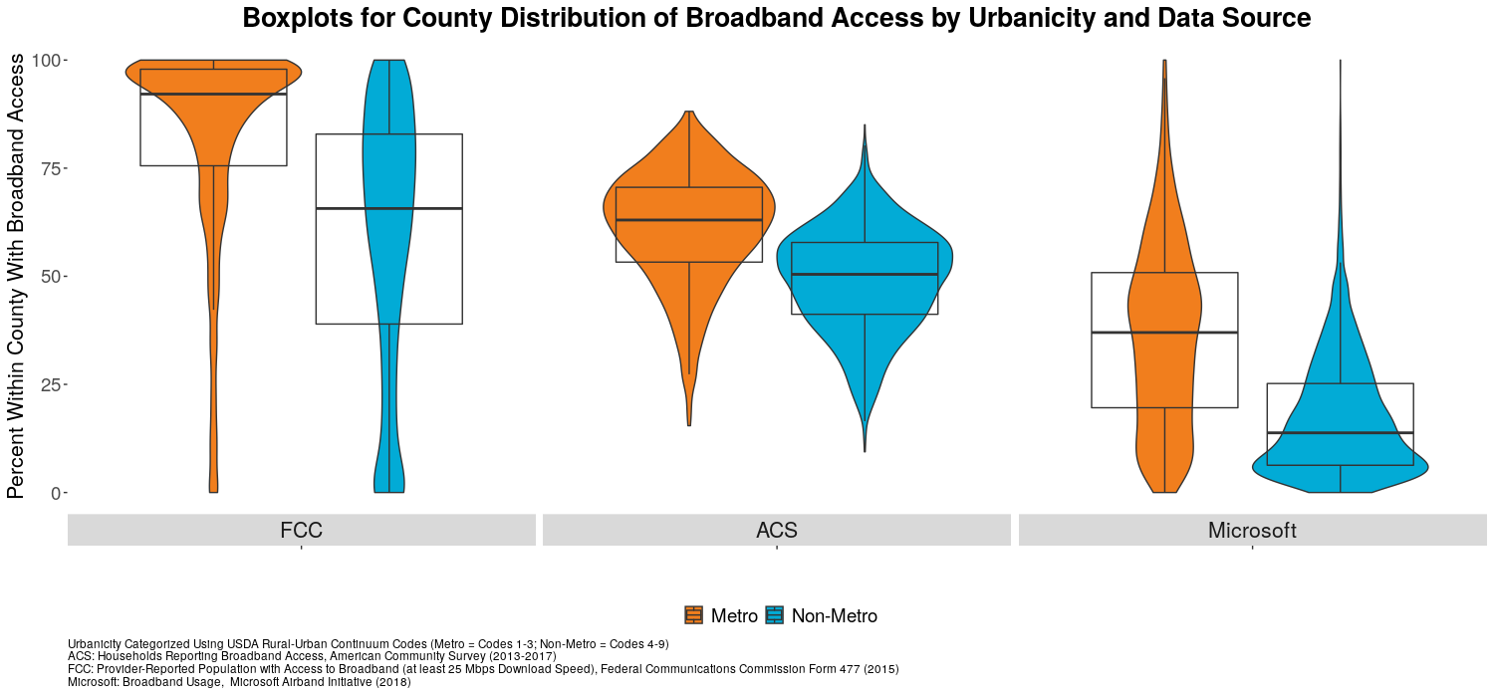
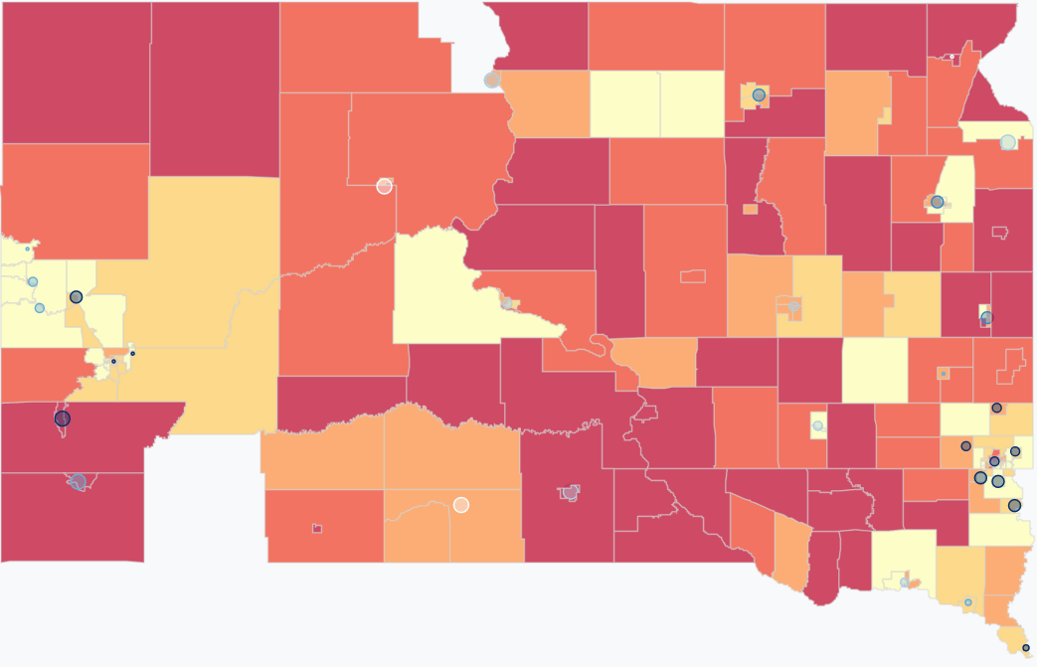
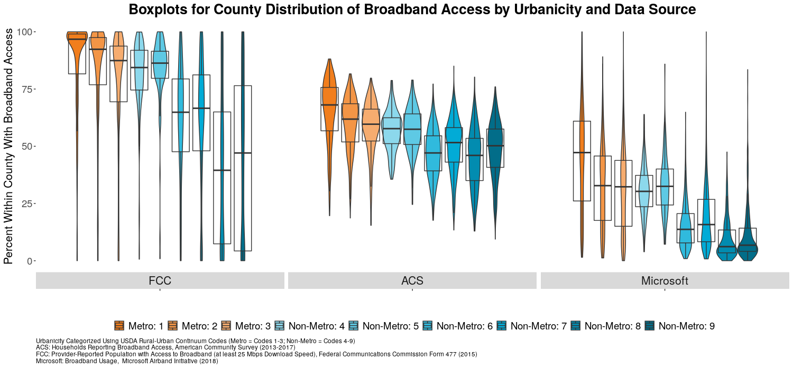
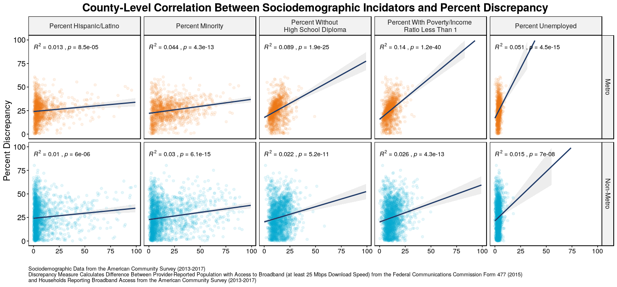

Broadband Data Validation: Comparing US Broadband Coverage
Kat Savchyn (Georgetown University), Sarah McDonald (Marymount University), Raghav Sawhney (Virginia Tech)​
Teja Pristavec, Josh Goldstein, Stephanie Shipp (SDAD)
Introduction
Social & Decision Analytics Division
The broad purpose of this project explores whether broadband development affects rural prosperity, as measured by changes in property values and quality of life indicators in rural communities. The first component of the project conducted a comprehensive literature review of value modeling consisting of factors other than broadband that shape property values. We found relevant environmental, neighborhood, structural, and locational attributes that influence property prices. The second component of this project explores methods of validating Federal Communications Commission (FCC) broadband data. Following the Consolidated Appropriations Act, the United States Department of Agriculture (USDA) created the ReConnect Program, which provided $600 million in loans and grants for broadband improvement in rural areas. The FCC provides data on broadband, FCC Form 477, which informs broadband funding policies, but has known limitations.
Data
FCC FORM 477
American Community Survey (ACS)
BroadbandNow
Microsoft Airband
    Receives self-reported data from broadband providers, potentially introducing error if advertised coverage estimates are reported rather than actual estimates.
    If a census tract had just one subscriber, the entire census tract is assumed to have broadband.
Claims that broadband is not available to 25 million Americans
The survey provides more detailed socioeconomic information than the decennial Census form
Table B28002: Presence and Types of Internet Subscriptions in Household for the 2013-2017 Five-Year Summary provided data specific to broadband
Receives self-reported data from households, but does not include group quarters
Online search engine which lists information for broadband availability on the zip code and city level
Provides information regarding the number of providers, maximum and average upload and download speeds as well as the change in broadband speeds over time.
Finds that around 163 million Americans do not use the internet at 25 Mbps, or broadband speed.
Microsoft calculated this by analyzing its servers’ logs when electronic devices downloaded Microsoft Windows and/or Office updates, as well as when devices used the Microsoft’s Bing search engine and Xbox gaming consoles.
Validation Methodology
Findings
Explored the broadband coverage discrepancy between the FCC and ACS data in North and South Dakota to understand the effect of state boundaries and policies on broadband availability.
We notice higher coverage discrepancy in the more rural parts of ND and SD
The south-west section of ND is majorly urban compared to the rest of the state and we can clearly see a difference in broadband coverage across the north east portion of SD which is purely rural
North Dakota is a largely rural state that has experienced a surge in broadband availability mainly due to the Broadband Technology Opportunities Program (BTOP) as well as a large-scale introduction rural cooperatives (co-ops) that are made up of local service providers in the area₁.
Broadband coverage discrepancy map for North
Dakota and South Dakota at block group level
Discussion & Further Research
See Our Shiny App Here…
QR code
Notes:
e

